Slide 1
Pascagoula Collaborative Community Meeting
Updates on Federal Projects/Activities
Superfund Site - MS Phosphates
Presenter – Craig Zeller, EPA
March 26, 2021

Slide 2

MISSISSIPPI PHOSPHATES CORPORATION
Pascagoula, Jackson County, MS
U.S. EPA Region 4
Superfund & Emergency Management Division
March 2021

Slide 3
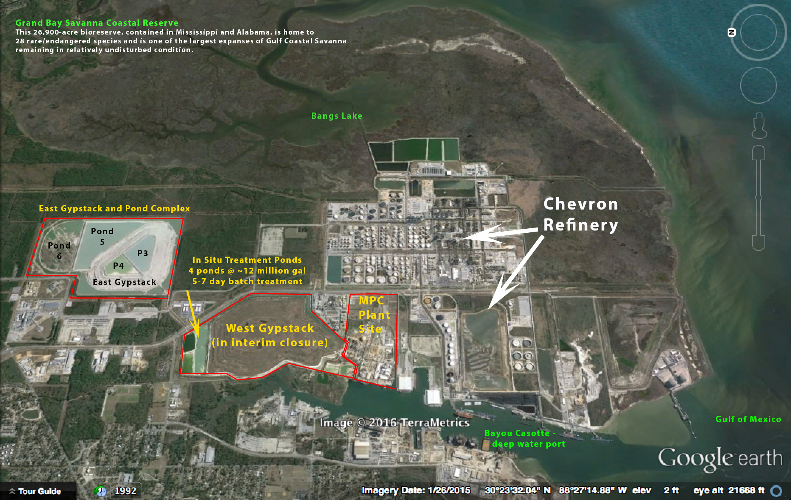

Slide 4
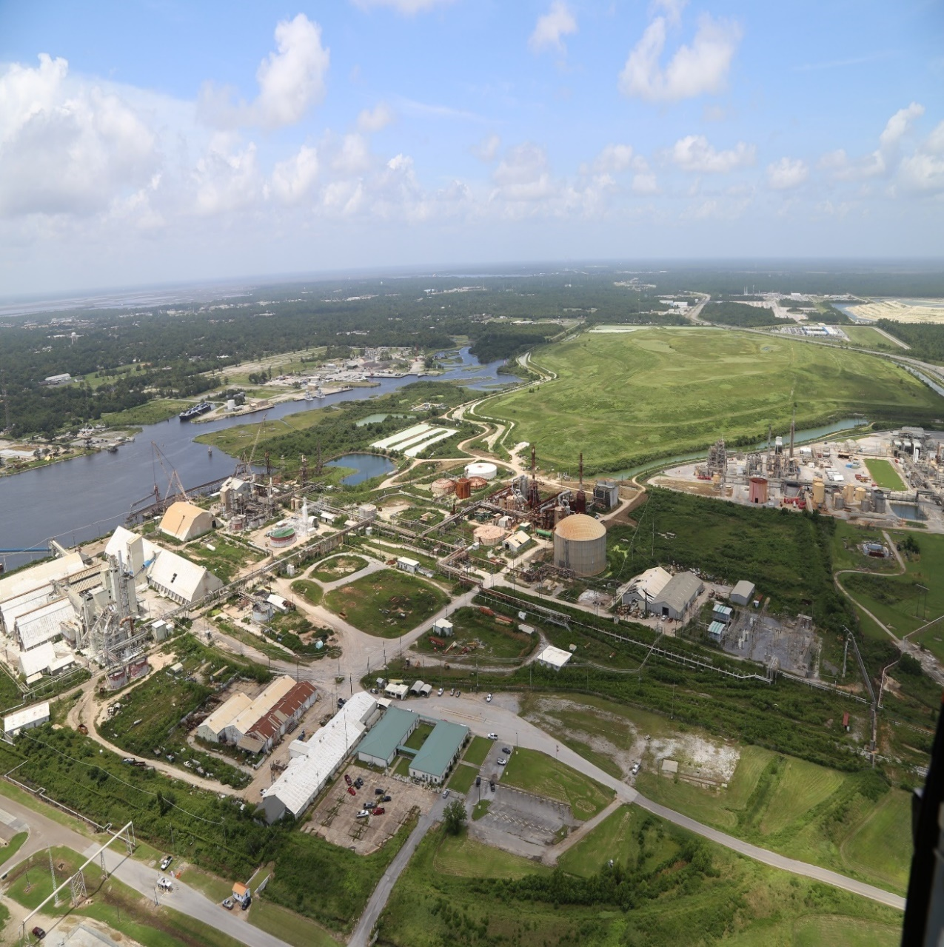
LIQUIDATION TRUST UPDATE
Liquidation Trust dissolved at the end of July 2020.
All assets/property transferred over to the Environmental Trust.
Primary goal shifted from marketing/sale of property to addressing any immediate on-site environmental/safety hazards.
Notes:
View in foreground is the approximate 106 acre Liquidation Trust. Deep water dock is considered most valuable asset of property.
Green mound in background is the West Gyp Stack that was closed in 2005. It generates an estimated 20,000 gallons of leachate that is treated by the mechanical lime plant. The WGS has consolidated about 30 feet in height since it was closed out.

Slide 5
Water Treatment Summary Statistics

Slide 6
EAST GYPSUM STACK CLOSURE PROGRESS
Phase 1A construction started November 2018/finished April 2020
  Total Costs = $14.3 Million
  $6.2 Million Earthwork/$8.1 Million Cover System
  49 acres of Turf/7 drainage bridges
Phase 1B construction started November 2019/finished December 2020
  Total Costs = $12.2 Million
  $6.2 Million Earthwork/$3.6M cover system materials/$2.4 Million installation
  46 acres of Turf/8 drainage bridges
Clean storm water runoff from ≈ 100 acres diverted to Bayou Casotte (without treatment)
Sole source procurement of 154 acres of ClosureTurf® cover system January 2020
  Cover material needed for Phase 1B + Phase 1C
≈ $35 Million spent on East Gypsum Stack closure thru 2020
Notes:
View in foreground is the approximate 106 acre Liquidation Trust. Deep water dock is considered most valuable asset of property.
Green mound in background is the West Gyp Stack that was closed in 2005. It generates an estimated 20,000 gallons of leachate that is treated by the mechanical lime plant. The WGS has consolidated about 30 feet in height since it was closed out.

Slide 7
EGS CLOSURE WORK 2021 - Phase 1C
Includes closure of NE slope, Pond 5 and conversion of open WRD to closed leachate collection system
Easily the biggest engineering & construction challenge of EGS closure project
Much larger work area than Phase 1A/1B
  NE Slope + Pond 5 = 125 acres
  WRD = 42 acres
  914,500 CY of fill/422,300 CY cut
  Total estimated cost = $40 Million
Work on Phase 1C subgrade started week of 03/22/2021
  $4 Million initial funding for 6-month scope
  Full contract award for Phase 1C completion later this year
Phase 1C completion will require 3 years
Phase 2 (Pond 6) + Phase 3 (North Ponds)

Slide 8
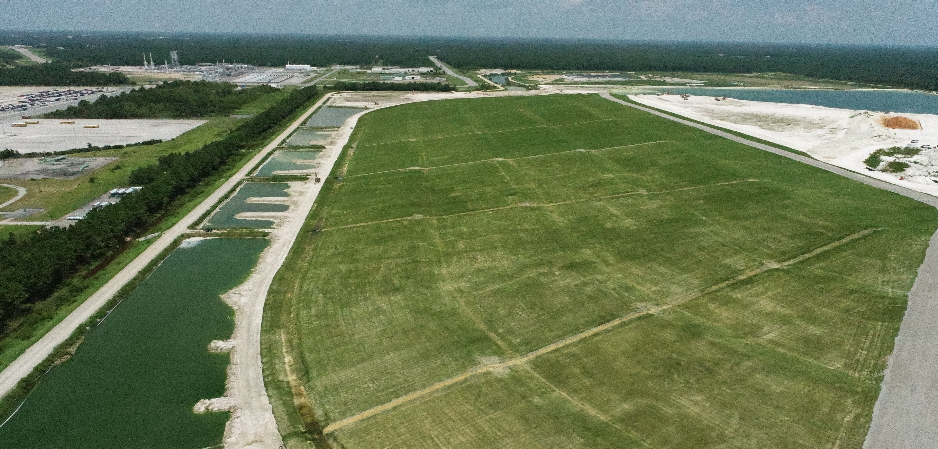
Phase 1A Complete (looking North)

Slide 9
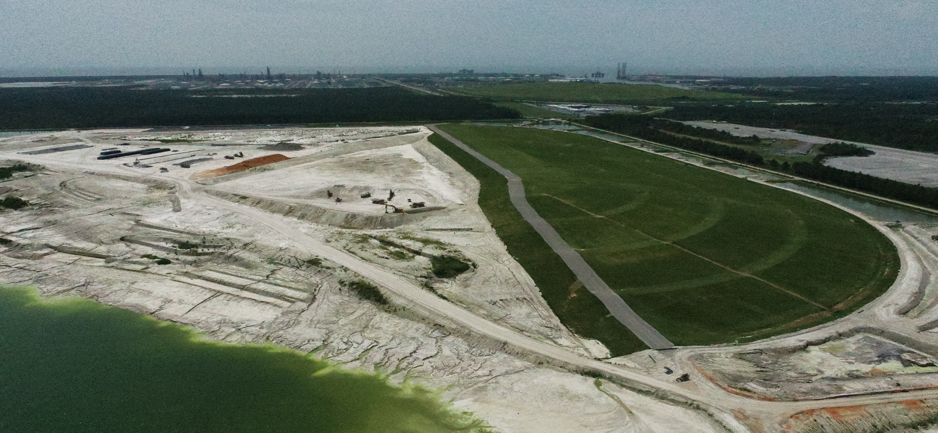
Phase 1A (right) + Phase 1C work area(left)
(looking South)

Slide 10
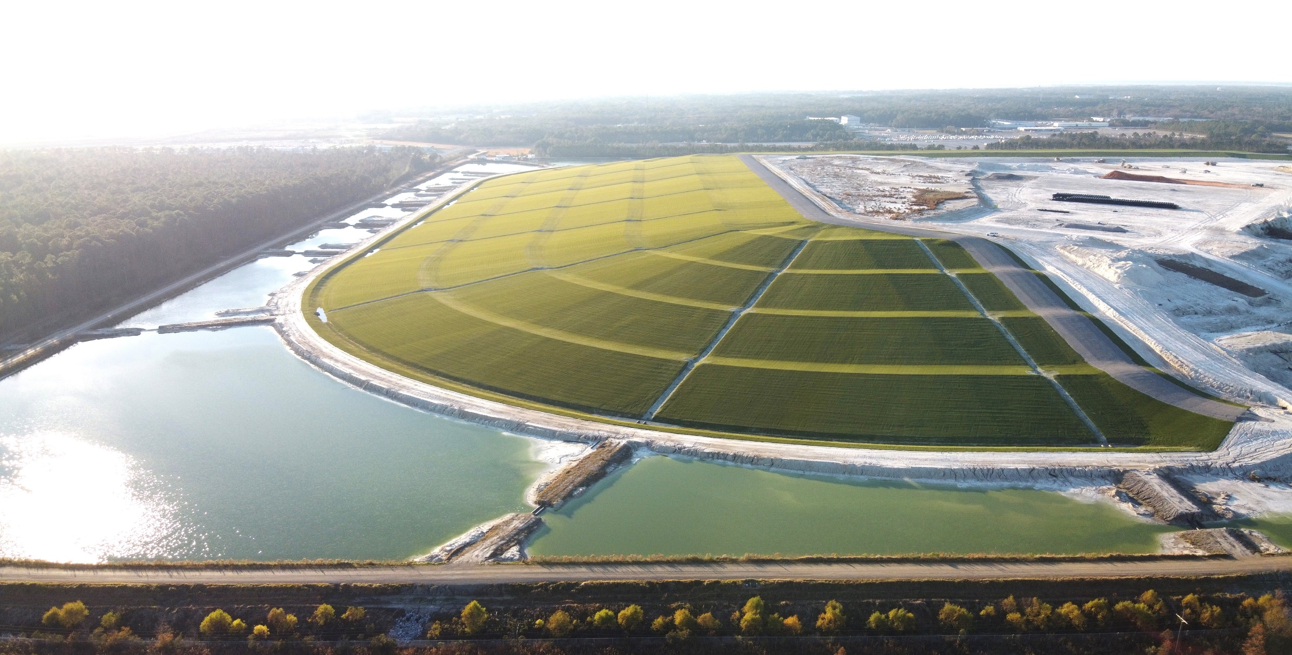
Phase 1B Complete (looking West)

