Slide 1
Composting
Recycling Food Scraps through Nature
Notes:
Slide 1: Composting, Recycling Food Scraps Through Nature
In this presentation, we are going to learn what compost is and how we can use composting to recycle food scraps in order to grow more food.
Ask the students to raise their hands, if they compost at home. Tell the students who raise their hands “That is great! I will count on you to help me with the presentation a little later by sharing your experience.”

Slide 2

Soul Food or Soil Food?
Notes:
Slide 2: Soil Food
This presentation is about using composting to recycle food scraps to grow more food. Soil has something to do with our food. Who agrees with this? Raise your hand if you agree. This short video explains the importance of soils. Let’s watch.
After the video: It seems all food is “soil food”. Do you agree? Now let’s talk a little more about soil.

Slide 3
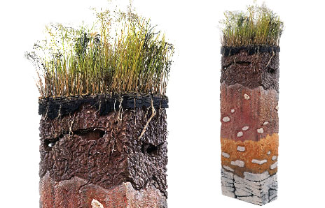
What on Earth is Soil?
45% Minerals
  Sand, silt, clay
25% Water
25% Air
5% Organic matter
  Dead, decaying plants, animals and other organisms
Topsoil
Subsoil
Bedrock
Image courtesy of USDA NRCS.
Notes:
Slide 3: What on Earth is soil?
Soil is a complex mixture of minerals, water, air and organic matter from dead, decaying plants and animals. Soils vary from one location to another depending on the kinds of rocks and how much these rocks have broken down; how much organic matter is in the mixture; and how much water and air the soils contain.
Soil composition:
About 45% of the soil is composed of minerals, mostly rocks that have broken down over time into solid particles of sand, silt and clay. Sand particles are the largest and clay particles the smallest. Although a soil could be all sand, all clay or all silt, that's rare. Instead most soils are a combination of the three. Sand is the largest particle and feels gritty when rubbed between the fingers. In coastal areas, beach sand also contains broken down pieces of shells, coral and other tiny marine species. Silt is the medium-sized particle. It feels smooth like flour. Individual silt particles are barely visible. Clay is the smallest particle and cannot be seen by the unaided eye. Clay feels sticky when wet.
Most soils have 25% water and 25% air. There is not exactly 25% of each as these amounts can change due to rain, drought and other conditions. However, the soil composition is about 25% for each most of the time for most soils. In coastal areas, it is a little different as soils in marshlands, swamps, bayous and wetlands have more water because they get flooded frequently with changes in the tides.
The smallest fraction of soils is organic matter, which is about 5%. Organic matter consists of dead plant and animal tissue and the micro-organisms that live in the soil. While organic matter accounts for only about 5% of the volume of the soil, it is a very important part of the soil. Organic matter has many functions, including providing food for organisms, helping hold the water in the soil, providing nutrients for plants and more. Soils in marshlands, swamps, bayous and wetlands typically have higher organic matter content than most soils, which means more food for organisms. That is why these areas are considered nurseries for baby shrimp, fish and other aquatic species.
Soil horizons image: The layer called “topsoil” is where most of the organic matter is located. The upper part of the top soil has a thin layer of fresher organic matter that is decomposing or breaking down. This picture shows three different layers of subsoil. The upper subsoil will have more organic matter. As we go deeper, the subsoil contains more minerals because it is closer to the bedrock from which it is formed.
Soil is like the Earth’s skin. Just as we can’t live without our skin, we can’t live without soil. Why? Because soil performs many functions that are fundamental for life.
Before moving to the next slide, ask the students “What are some of the functions of soil that make it so important for life on Earth?” and wait for their answers.
The above discussion is based on information from the following resources:
SoilScienceInfo.Net http://soilscience.info/index.php
Soil Science Society of America https://www.soils.org/
USDA Natural Resources Conservation Service: http://www.soils.usda.gov/sqi/concepts/soil_biology/biology.html

Slide 4
We Soils!
Provide nutrients and a place for plants & animals to grow (our food!)
Habitat for soil organisms
Recycle organic matter into nutrients
Filter and purify the water we drink and use
Help maintain clean air
Where we build our houses and cities
Notes:
Slide 4: We heart soils!
What are some of the functions of soil that make it so important for life on Earth?
1) Soils provide nutrients and a place for plants to grow and most of our food comes directly or indirectly from plants
2) Soils provide the habitat for soil organisms--mostly microscopic creatures that account for most of the life on Earth. Soils are so full of life that the soil itself seems to be alive.
3) The microorganisms in soils help process and recycle nutrients, including carbon, so that living things can use them over and over again. The dead plants and animals are recycled into nutrients.
4) Soils can filter and purify the water we drink and use every day. Microorganisms can use some of the chemicals present in our waters as food by breaking them down (biodegradation).
5) Soils modify the atmosphere by emitting and absorbing dust and many gases, including carbon dioxide, methane and water vapor.
6) Our houses, buildings, cities are built on top of soil and made of materials that came directly or indirectly from soil.
The discussion above is based on information from the following resources:
SoilScience.Info http://soilscience.info/
Soil Science Society of America https://www.soils.org/
USDA Natural Resources Conservation Service: http://www.soils.usda.gov/sqi/concepts/soil_biology/biology.html

Slide 5
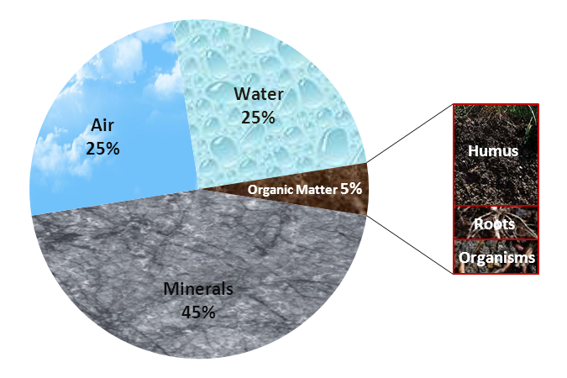
Humus to Hummus
Notes:
Slide 5: Humus to Hummus
Who likes to eat hummus? The hummus that we eat is spelled with two m’s. Humus with one “m” is what soil scientists call the portion of the organic matter in the soil that is already decomposed. Humus is formed when the organic matter decomposes. When you go to a forest or your yard and lift a layer of leaves that have been there for a while, sometimes you will find a layer of dark, spongy material that looks like soil and smells earthy. This is humus.

Slide 6
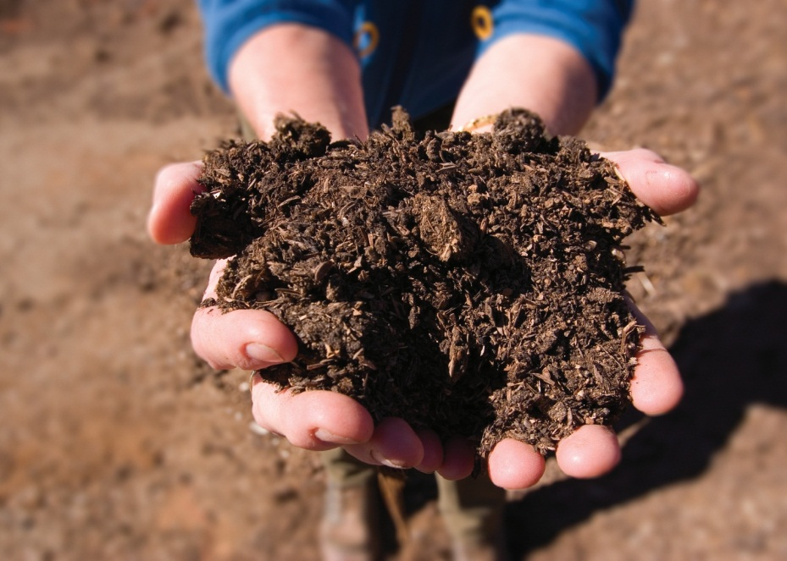
What is Compost?
The product from the biological degradation of organic waste materials
In other words: humus!
Image courtesy of USDA NRCS.
Notes:
Slide 6: What is Compost?
Compost is the product of biological degradation of organic waste materials. It is the same as humus, but made by us through the composting process. By composting our organic wastes, we can help nature make the humus it needs for soils. We can manage composting so the biodegradation happens faster than it would happen in nature.

Slide 7
The Composting Not-so-Secret Recipe
The right food for decomposers
Decomposers
Water
Air
Notes:
Slide 7: The Composting Not-so-Secret Recipe
There are four basic things we need for composting. The first is organic wastes, which are the food for the decomposers. Then we need decomposer organisms. We also need water and air. We will discuss this in more detail in the next few slides. The great thing about composting is that we can control the process.

Slide 8
A Balanced Diet
Carbon (C) rich materials provide energy for microbes and other decomposers
  Leaves, wood, paper, cardboard, etc.
  Also called “browns”
Nitrogen (N) rich materials provide the Nitrogen needed for cell function
  Food waste, manure, grass, etc.
  Also called “greens”
C:N ratio
  Optimum is between 25:1 to 30:1
  Or, 5 parts of browns to 1 part of greens
Notes:
Slide 8: A Balanced Diet
Organic matter, such as leaves, grass clippings, garden plants, kitchen scraps and shredded paper make excellent compost materials. Leaves, woody branches and paper have a high carbon content, which microorganisms need for energy. Grass clippings and vegetables are higher in nitrogen, needed to make the enzymes used in decomposition and other processes. In other words, carbon rich materials are the food and nitrogen rich materials are the vitamins. Achieving an optimum balance of carbon to nitrogen (C:N ratio) is important for effective composting. The optimum ratio is between 25 and 30 carbon atoms for each nitrogen atom. This is clearly not a practical form of measurement outside a very specialized laboratory. Therefore, we use a conversion of about five parts carbon to one part nitrogen or five buckets of browns to one bucket of greens.

Slide 9
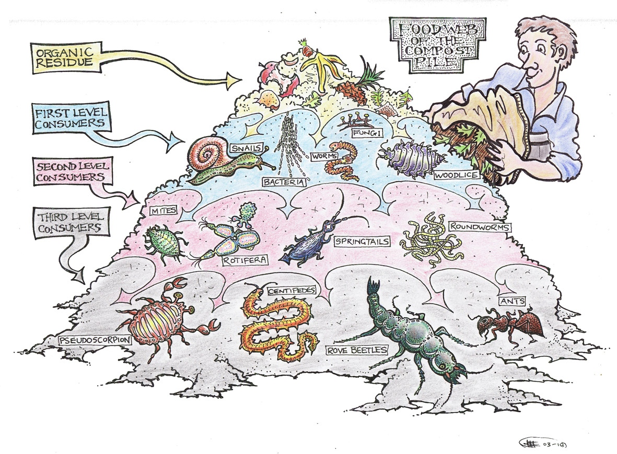
Decomposers
Source: Welcome to the Biology of Composting, StopFoodWaste.ie
Notes:
Slide 10: Decomposers
There are many decomposers in a composting pile. Soil organisms, such as bacteria, fungi and others, are largely responsible for starting the composting process. Since these organisms naturally occur in soil and vegetable matter, their presence is guaranteed. But you can always add a couple shovelfuls of compost or soil to provide “starter” decomposers for your pile.

Slide 10
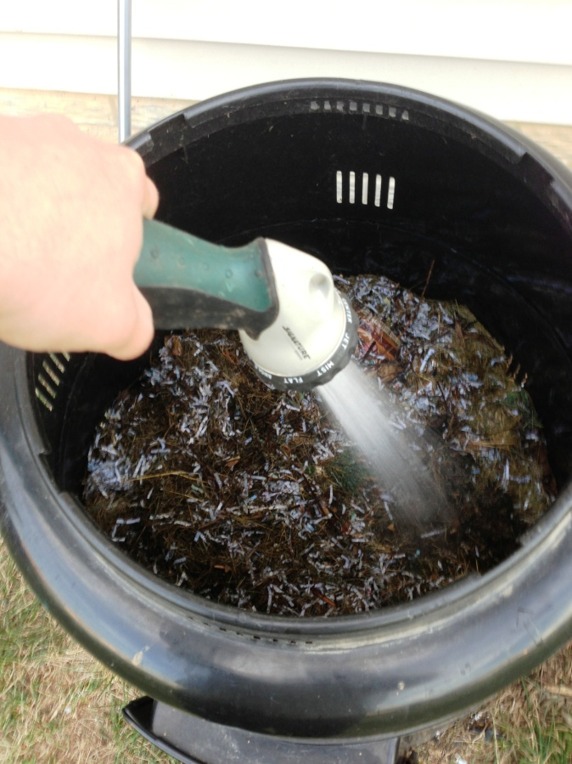
H₂O
Aim for 40-60% moisture
As wet as a wrung out sponge
Source: Angel Arroyo-Rodríguez
Notes:
Slide 10: Water
Water is essential for composting. Just like us, microorganisms need water to survive and be active. A moisture level of 40 to 60 percent is best. Your compost pile should be about as wet as a wrung-out sponge. If it is too soggy, the bacteria and other beneficial organisms will not get enough air. On the other hand, a lack of moisture will cause microorganisms to go dormant and delay the composting process.

Slide 11
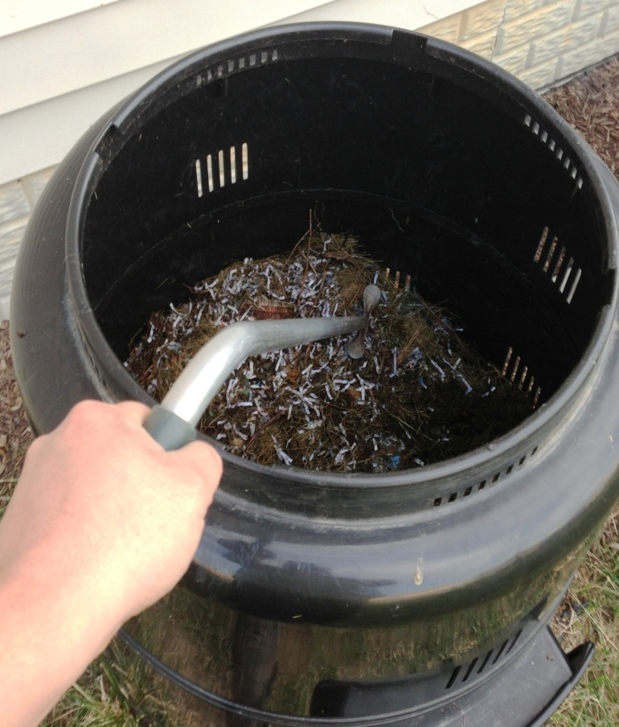
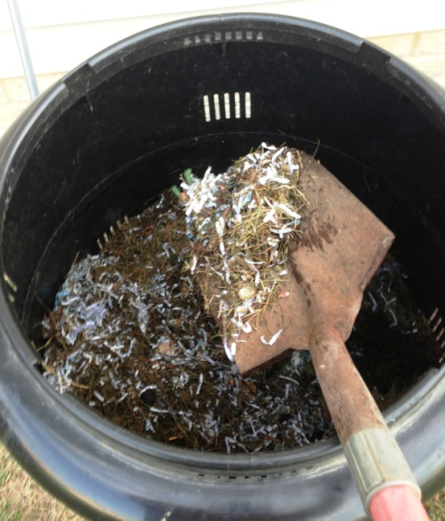
Air
Organisms need oxygen (aerobic process)
Turn pile to increase porosity and air can flow through the pile
Source: Angel Arroyo-Rodríguez
Source: Angel Arroyo-Rodríguez
Notes:
Slide 11: Air
Oxygen is vital because composting is essentially an aerobic process. Aerobic means that the bacteria need oxygen to live and perform specific functions. If the air supply is cut off, anaerobic bacteria will take over, resulting in unpleasant odors. To ensure that enough oxygen is available, turn your compost pile. Turning also brings the outer, less decomposed portions of the pile into the center where the soil organisms do their work.

Slide 12
How Does It Work?
Graph by Dr. Harold Keener, Ohio Agricultural Research and Development Center
Ambient Temperature
High Heat
Ambient Temperature
Raw Material
Active Composting
Stabilizing/Curing
Notes:
Slide 12: How Does It Work?
When bacteria and other microorganisms start feeding on organic material, they generate heat. This process is similar to us getting hot when we exercise. At the beginning of the process the raw materials are at a normal ambient temperature. As organisms start feeding on these materials, they generate heat. Eventually it gets hot enough that only organisms that can live at these high temperatures become active (the others go dormant or die). Once the high heat organisms use up all the food, they start to go dormant and the heat goes down again.
The maximum decomposition occurs when compost temperatures range from 110-150 degrees F. Therefore, temperature is a good indicator of effective composting. At these temperatures weed seeds and most disease causing microbes and parasites die. It takes three days at 131 degrees F (55 degrees C) to kill parasites and plant pathogens. It is important that piles are turned frequently to ensure that all parts are exposed to these high temperatures. You may see steam when you turn the pile. A larger pile size helps retain heat. As the temperature exceeds 150 degrees F, the composting rate drops rapidly and becomes negligible at temperatures higher than 160 degrees F.
The discussion above is based on information from: The Composting Process. The Ohio State University Extension, Bulletin 792 http://ohioline.osu.edu/b792/b792_2.html

Slide 13
Get Ready to Compost!

Slide 14
Good to Go
Browns
Greens
Leaves, twigs, woody plant parts
Straw, hay
Sawdust, wood chips (clean wood)
Shredded paper, newspaper, cardboard
Non-recyclable paper goods
  Paper towels, napkins
  Paper plates & cups not coated with plastic
  Soiled cardboard (pizza boxes, ice cream cardboard tubs)
Old mulch & potting soil
100% cotton, linen & wool fabrics (cut in small pieces)
Grass clippings, garden plants
Indoor plants, cut flowers
Weeds (without seeds)
Food Scraps
  Fruit & vegetable trimmings & peels
  Coffee grounds & filters, tea bags
  Breads & other bakery goods
  Rice & other grains
  Pasta & cereals
  Egg shells
Farm animal manure
Vegetarian pet cage waste (hamster, guinea pig, rabbit)
Notes:
Slide 14: Good to Go
Here is a list of common organic wastes that we find at home and school. They are listed as either browns or greens. Remember, green materials have more nitrogen than brown materials.
Browns:
Dried leaves, twigs, hedge clippings, tree branches and any other woody parts of a plant are high in carbon. Green leaves are considered to have a higher amount of nitrogen; however, you can consider a tree branch with green leaves as mostly brown.
Dry straw and hay are considered browns
Sawdust, wood chips (clean wood). Clean wood means that it has not been painted, glued, covered in plastic, etc.
Shredded paper, newspaper, cardboard
Non-recyclable paper goods refers to paper or cardboard that cannot be put in the regular recycling bin. These include paper towels, napkins, and disposable paper plates and cups that are not coated with plastic. All of these materials can be composted even if lightly soiled with food and should be cut or torn into smaller pieces so they will compost quickly. Similarly, cardboard soiled with food, such as pizza boxes and ice cream cardboard tubs, can be composted. Cardboard ice cream tubs are usually covered in wax. While that makes them hard to recycle, microbes can eat the wax so they can be composted. All wax covered cardboard can be composted.
Old mulch and potting soil, and even compost can be added to the pile. The potting soil will not decompose much, but it will add decomposers.
Also, fabrics made of 100% cotton, linen or wool can be composted. They must be cut into small pieces otherwise they will not compost at the same speed as the other materials.
Greens
Material with higher nitrogen content is consider as greens. All the plant parts that are green are high in nitrogen, so that helps us remember. Grass clippings, garden plants, indoor plants, cut flowers and even weeds are consider green. We have to be careful to not include weeds seeds, as they might not be destroyed in a backyard composting system.
All food scraps are compostable, if we can eat it, so can the microbes. However, for a backyard setting, these are the food scraps recommended: fruit and vegetable trimmings and peels, coffee grounds & filters, tea bags, breads, donuts and other bakery goods, rice and other grains, pasta and cereals, and egg shells. Eggshells are not really that high in Nitrogen, but they were listed with the food wastes so it is easier for us to remember.
Cow, pig, horse, llama, alpaca, bison and chicken manure are also ok. All manure is rich in nitrogen, but it is only recommended that you use manure from farm animals as they rarely carry diseases that affect us. For the same reason, only pet waste from pets that eat only plants is recommended.

Slide 15
Not So Fast!
Best not to compost at home:
Diseased plants or plants infested with insects
Weeds that spread by root or runner or weeds with seeds
Painted or treated wood
Dairy products (cheese, yogurt, etc.)
Meats
Bones and shells
Cooking oils, fat or grease
Dog and cat pet waste
Compostable plastics
Vacuum cleaner bags
Notes:
Slide 15: Not So Fast!
There are some organic and compostable wastes that are not recommended for backyard or other types of small-scale composting, such as school or community garden projects. These materials should only be composted by people with lots of experience and large piles or facilities.
We will go through each of these waste materials and give the reasons why they may cause trouble:
Diseased plants or leaves - Piles often do not get hot enough to destroy all plant diseases.
Insect-infested plants - Piles often do not get hot enough to destroy all eggs, larvae and adult insects.
Weeds that spread by root or runner - Some weeds will not decay during the composting process. Therefore, they could survive and spread.
Any animal products or parts (meat, fish, poultry) – Piles are not large enough to heat up quickly and filter potential odors. Animal products can also attract pests.
Bones and shells - Slow to compost, especially in smaller piles. Can cause odors
and attract pests as do animal products.
Dairy products - Piles are not large enough to heat up quickly and filter potential odors. Dairy products can also attract pests. However, limited amounts of milk and melted ice cream can be used to add moisture to piles. The microbes in the pile like the sugars in these liquids and will use them up quickly. Piles should be on the drier side before adding liquids.
Cooking oils, fat or grease – Too heavy, can clump the materials in the pile and reduce air flow, thus causing odors and attracting pests
Dog and cat pet wastes - May contain pathogens that could spread disease, cause odors and attract pests (flies).
Compostable plastics – These products are disposable forks, spoons, straws and containers made of special plastics derived from plants. They look like regular plastic, but they will compost. However, they must be exposed to the composting heat and moisture levels in order to break down quickly. Therefore, it is not recommended to put them inside a backyard or small composting bin. In an enclosed bin, compostable plastics can take more than a year to compost.
Content of vacuum cleaner bags - Not all bags and/or contents are biodegradable. This is especially true with bags from vacuum cleaners used in homes with installed synthetic carpet.

Slide 16
Assembling a Composting Pile
Start with bottom layer of brown material
Alternate green and brown materials
Finish with cover layer of brown material
Add water until pile is as wet as a wrung out sponge
Brown material
Green material
Brown material
Green material
Bottom layer (brown material)
Notes:
Slide 16: Assembling a Composting Pile
This is the basic way to assemble a composting pile. First, create a bottom layer, three to six inches thick, of brown materials. This will help absorb excess moisture from your green materials. Then, place your green materials on top and alternate with layers of brown. By alternating layers, you will ensure that you have enough brown material to absorb excess moisture and help you achieve an optimum carbon to nitrogen ratio. (This is a good opportunity to ask the students to tell you the optimum C:N ratio).
When starting a pile, layer it this way, wait about a week then mix it well by turning it.
If you don’t have a lot of green materials, you can start with just one layer and keep building it up as you collect more materials.
You can assemble a pile like this in the open (with no side walls).

Slide 17
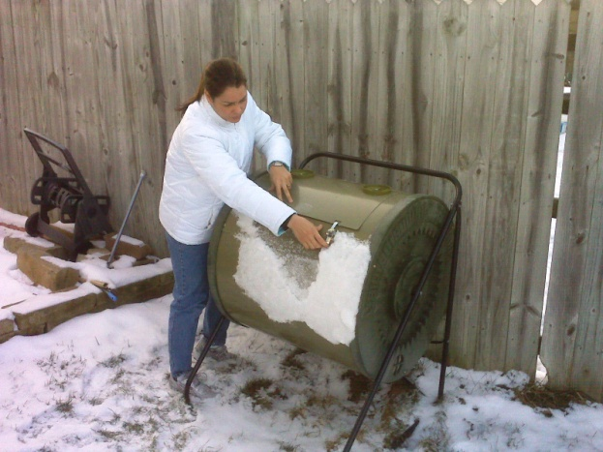
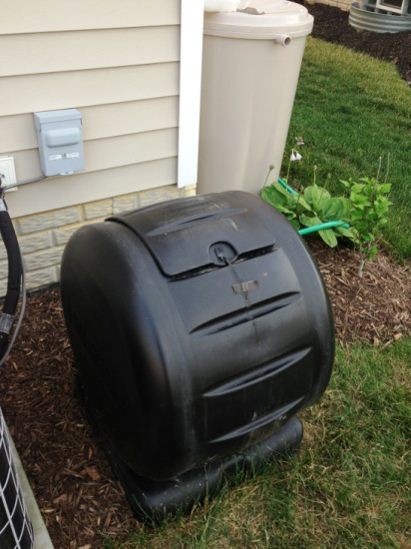
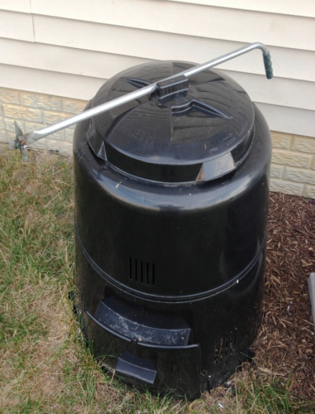
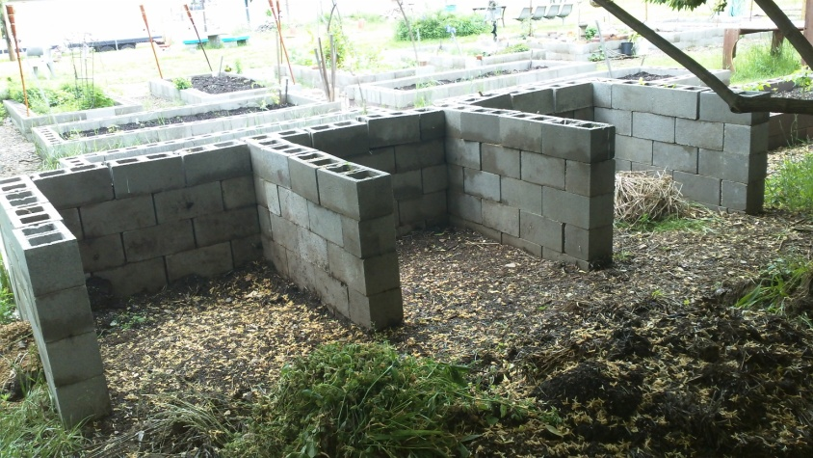
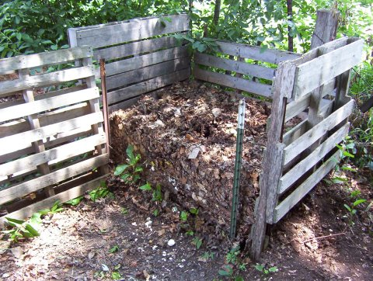
Bins
Source: Angel Arroyo-Rodríguez
Source: Angel Arroyo-Rodríguez
Source: Angel Arroyo-Rodríguez
Source: James Murray-White, GreenProphet.com
Source: Lucille Beachdell
Notes:
Slide 17: Bins
Here we see some examples of backyard and small-scale composting bins. You can buy bins in different sizes and shapes, or you can construct your own. As we discussed earlier, a bin is not really needed, but many people prefer one. Using a bin that closes is ideal if you want to compost food scraps and you have a curious pet or live near fields with wildlife. Using a bin with a lid also helps you keep your pile tidy.
The bins at the bottom left are commonly referred to as three-sided bins.

Slide 18
Tips for Success
Turn (mix) the compost pile every couple of weeks or each time you add new material
Maintain an ideal pile size of 3’x3’x3’ to help retain heat and preserve good air flow
Don’t had thick layers of any one kind of waste
  6” to 8” for brown material
  3” to 5” for green material
Smaller pieces will compost quicker than larger pieces. Shred brown material if possible
Notes:
Slide 18: Tips for Success
I want to share some general tips to help you make composting more successful. Turn (mix) the compost pile every couple of weeks or each time you add new material. Turning aerates the pile and will expose the outer portions of the piles to the high heat in the center of the pile.
Maintain an ideal pile size of 3’x3’x3’ to help retain heat and preserve good airflow. This is not as important if you are using one of the enclosed bins as the pile is the size of the bin.
Don’t add thick layers of any one kind of waste:
6” to 8” for brown material
3” to 5” for green material
Smaller pieces will compost quicker than larger pieces. Shred waste materials if possible.

Slide 19
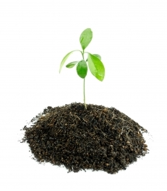
Is It Done Yet?
Compost is done when it is dark, crumbly and has an “earthy” smell
How long does it take?
Short period (3 weeks to 2 months)
Long period (2 months or more)
Image courtesy of Mater isolated images/ FreeDigitalPhotos.net
Notes:
Slide 18: Is It Done Yet?
Compost is done when it is dark, crumbly and has an “earthy” smell. How long the material takes to compost will depend on how we started the pile and how much we cared for it.
A short period is considered between three weeks and two months. For the materials in a pile to compost this quickly, the pile should be assembled using mostly smaller pieces of material. The pile should be big enough to retain heat. The appropriate amount of moisture should be added to the pile when needed and the pile should be turned frequently. A long period is considered to be between two months and a year. Composting will take longer if the pile is made up of primarily larger pieces of material, is allowed to dry up often, is small or is not turned frequently.
Also, the kind of materials play a big factor in how long composting takes. For example, wood chips can take as long as a year or more to compost! Therefore, a pile with lots of wood chips will take longer to become crumbly compost. On the other hand, green materials compost more quickly.

Slide 20
What’s That Smell?
Foul odors indicate anaerobic decomposition.
Solutions:
  Aerate the pile by turning
  Increase porosity by adding wood chips or wastes of larger size
  Add absorbent browns
  Hold the water until needed again
Notes:
Slide 19: What’s that Smell?
If the pile starts to smell like rotten eggs, this indicates that the material is decomposing anaerobically (without oxygen). When this happens, hydrogen disulfide, the chemical that causes the rotten eggs odor, is released. This usually happens because the pile is too wet and air can’t go through it, which allows anaerobic microorganisms to take over the pile.
This is easy to fix, although it might take a couple days for it to be completely fixed. The first thing to do is turn the pile to make sure that air gets through it. Another thing we can do is add woodchips or materials of a larger size to increase porosity or air space. We can also add absorbent browns such as shredded paper or cardboard to soak up the moisture. And last, stop adding water until the pile dries enough.

Slide 21
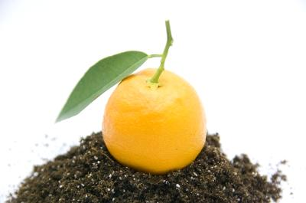
Composting is as much of an art, as it is a science
Image courtesy of Jeroen van Oostrom/ FreeDigitalPhotos.net
Notes:
Slide 20: Composting is as much of an art, as it is a science
This concludes the presentation. You have probably noticed that there is a fair amount of trial and error in composting. We know how some things should work, but sometimes they don’t work the way we expect due to factors out of our control. For example, maybe it rains a lot for many days and the pile is allowed to get too wet. Even in these unpredictable situations, by observing and troubleshooting, in time we can learn the art of composting.

Slide 22


Disclaimer
This presentation is a component of the lesson plan Managing Food Scraps for a Sustainable Food System, prepared under the auspices of the U.S. Department of Housing and Urban Development Regional Sustainability Planning grant program supporting regional food systems planning on the Mississippi Gulf Coast. The lesson plan was developed as a collaborative effort between the Ohio Environmental Protection Agency, the Mississippi Department of Environmental Quality, The Constituency for a Sustainable Coast and The Ohio State University.

